Slide 1

DESIGN AND SIMULATION OF SENTINEL GUN ASSISTED BY IMAGE PROCESSING FOR DEFENCE APPLICATION
By
A. AJEETH (15UMEC103)
K. BARANIDHARAN (15UMEC102)
A. THERI MUTHU SELVAM (15UMEC050)
Guided by
Mr. R. SAKTHIVEL MURUGAN (Asst.Prof/Mech)
Co-guided by
Mr. T. PALANIAPPAN (Asst.Prof/ECE)

Slide 2
INTRODUCTION
This prototype is going to develop for protecting the nation from the foreign terrorist entry through the border by shooting them by a self triggered gun attached in a multiple gun holder.

Slide 3
ABSTRACT
In this project we are going to develop a sentinel gun prototype which works on one of the method of Image Processing.
We adopt the Face Detection and Tracking Method from Image Processing.
This prototype takes the input from a webcam and process the image using the spyder software and then finally the hardware are drive using the microprocessor called Arduino (UNO)
It has two dc motors for rotating and tilting the gun according to the human movement.
In order to trigger the gun we are going to use a servo motor.

Slide 4
PROJECT OBJECTIVE
To avoid the soldiers suffering from over hotness and coldness due to winter and summer season.
To reduce the monitoring work of the soldier from morning to night.
To shoot an enemy if he cross the border when soldier is not there.
To reduce the death of border guard soldiers.
To guard the border 24×7.
To manage the sudden terrorist ingress.
To avoid the periodic alteration of soldiers from borders.
To trigger the gun automatically.

Slide 5
Need for the Project in Defence
Our soldiers are suffering from over coldness, hotness and flood during the winter, summer and rainy seasons. They can’t tolerate this type of climate
Due to natural calamities like snow slides, land slides soldiers may stuck in that, it may leads them to death.
Though our soldiers are monitoring the borders properly they can’t monitor for a full day. So a periodic alteration of soldier is there.
If a border guard fell in sick he can’t monitor the border properly.
If any terrorist or other foreign army men attack our soldiers, our soldiers may get injured severe.
Sometimes our soldiers are guard our boarder without sleep.

Slide 6
PROBLEM IDENTIFICATION
Periodic soldiers death
Guarding in unsafe environment
24×7 monitoring without sleep
Natural calamities
Soldiers fell in sick while guarding
Sudden terrorist attack

Slide 7
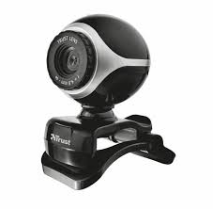


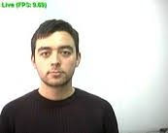
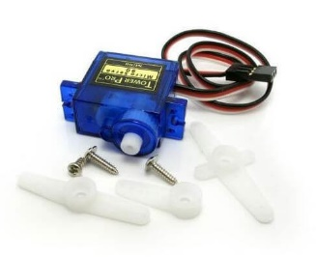
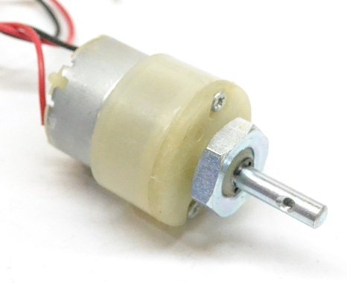
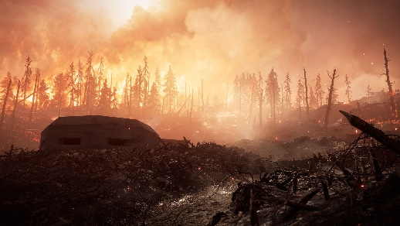
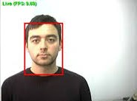
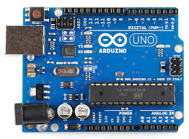
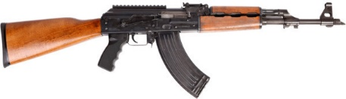
METHODOLOGY
Face detection
Centroid calculation and face tracking
Input
Triggering
Rotation
Tilt up and down
Arduino controlling
Output of spyder

Slide 8
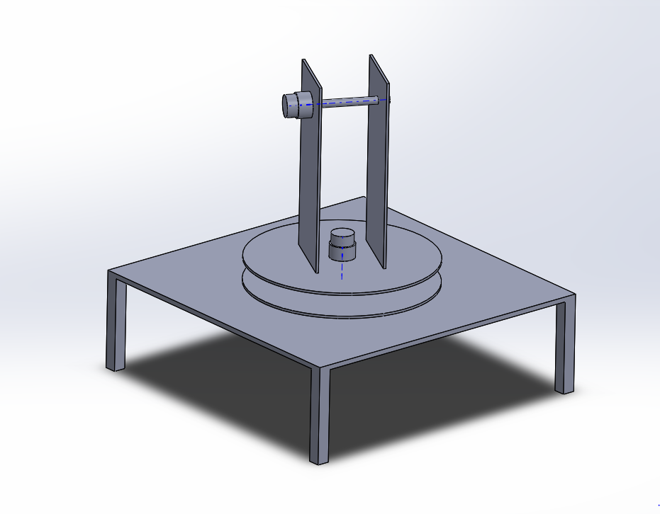
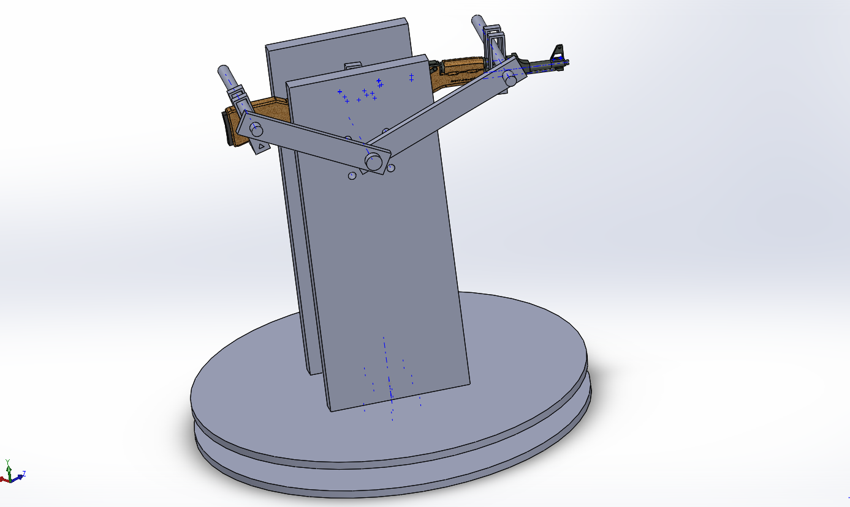
GUN HOLDER DESIGN
Exact Design
Prototype Design

Slide 9
MATERIALS REQUIRED FOR PROTOTYPE
Acrylic sheet
Nylon rod
12v 100 RPM dc motor
Stepper motor
Arduino UNO
L293d drive
Jumper wires
Webcam
Data cable

Slide 10
IMAGE PROCESSING TECHNOLOGY
Image processing is an technique in which the input is an image or a series of images or videos, such as photographs or frames of video. The output of image processing can be either an image or a set of characteristics or parameters related to the image.
It also means "Analyzing and manipulating images with a computer". Image processing is performed this three steps
First, import images with an optical devices like a scanner or a camera or directly through digital processing.
Second, manipulate or analyze the images in some way. This step can include image improvement and data summary, or the images are analyzed to find rules that aren't seen by the human eyes. For example, meteorologists use this processing to analyze satellite photographs.
Last, output the result of image processing. The result might be the image changed by some way or it might be a report based on analysis or result of the images.

Slide 11
SOFTWARE USED
Design
Solidworks
Image Processing
Anaconda
Spyder
Platform
Opencv
Arduino

Slide 12


Coding
Grey Image program
Grey coloured video program
Face Detection Program
Face Detection Program to Link Arduino
Arduino Coding
Video
baby.jpg
Babygray.png

Slide 13
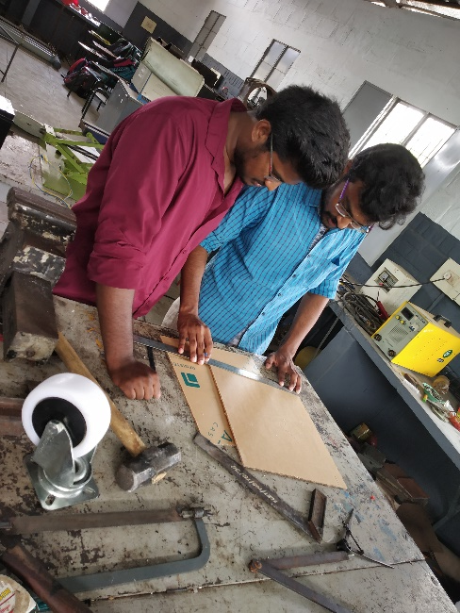
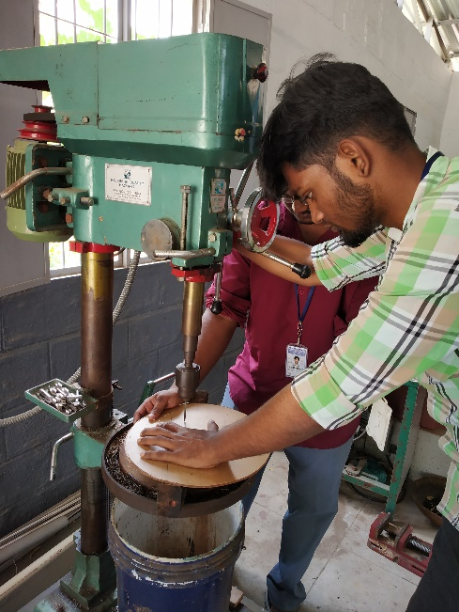
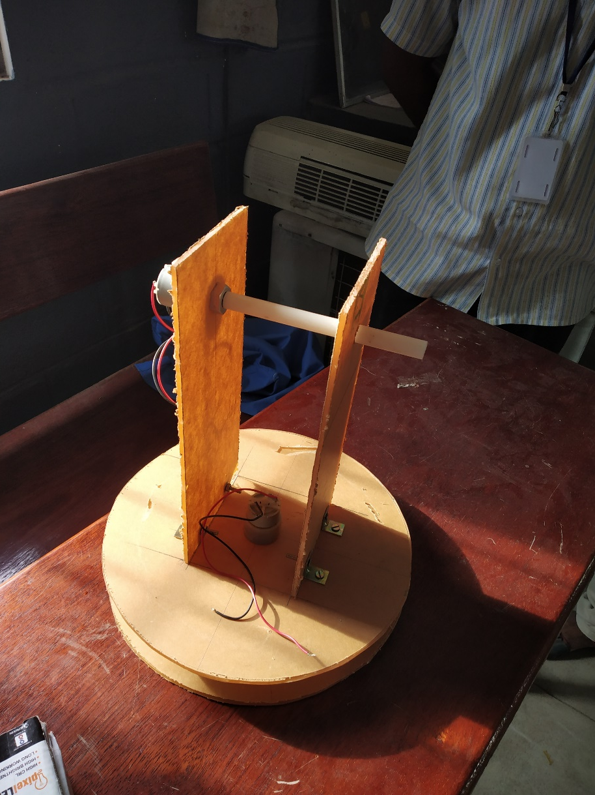
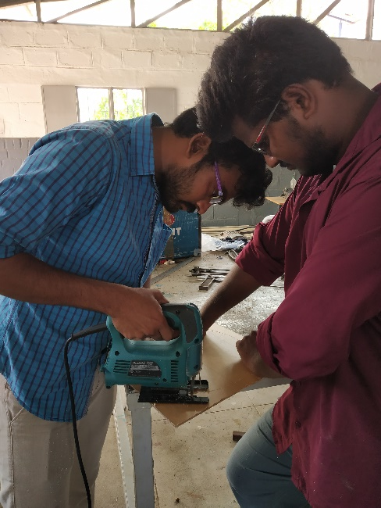
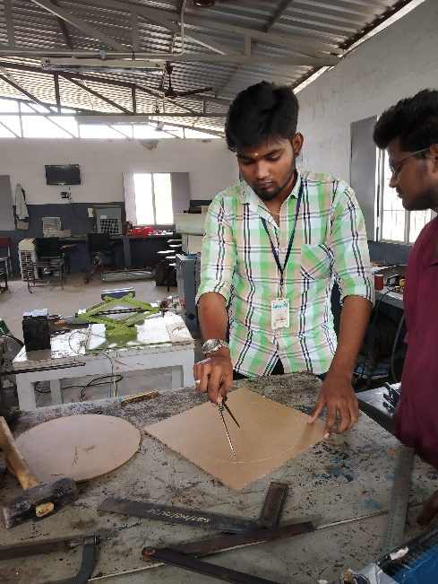
FABRICATED MODEL

Slide 14
WORK YET TO BE DONE
Arduino code to be load in UNO board.
To complete the pending fabrication work.
To apply for International Conference.

Slide 15
REFERENCE
Husnain Ahmad, Syed Mohsin Ali, Usman Ayub Sheikh, Zain Murtaza, Muhammad Rizwan, “Design and Manufacturing of a Low-Cost 2-DOF Semi Autonomous Sentry Gun” (IEEE Conference, pp.196-201, 2016).
Jean Kumagai, “A Robotic Sentry for Korea's Demilitarized Zone”, (IEEE Journals & Magazines, vol.44, pp.16-17, 2017).
3. Sam Shue, Dr. Claude Hargrove, Dr. James Conrad, “Low Cost Semi-Autonomous Sentry Robot”, (IEEE Conference, pp.1-5, 2012) 4.
https://opencv.org

Slide 16
Thank You

